Slide 1
CS174A Lecture 10

Slide 2
Announcements & Reminders
2/25/24: A3 due; will be discussed during this week’s TA session
3/03/24: A4 due
Team Project Timelines:
2/28/24: project proposals & teams due
3/01/24: midway demo, during regular lecture session, on zoom
3/13/24: final proposals due
3/15/24: final demos
3/19/24: Final exam

Slide 3
TA Session This Friday
Group formations in Canvas
Intro to Peerceptiv, used for peer evaluation
Team project proposals
Assignment #3
Hidden surface removals

Slide 4
Last Lecture Recap
Geometric Calculations
Midterm

Slide 5
Next Up
Hidden Surface Removal
Backface culling
Painter’s algorithm
Z-buffer algorithm
Scanline z-buffer algorithm
Lighting/Illumination Models
Flat and Smooth Shading
Shadow Algorithms
2-pass z-buffer algorithm
Hidden Surface Removal
Ray casting, ray tracing

Slide 6
Hidden Surface Removals
Object Types
Polymesh
Volume
Free form surfaces
CSG
Implicit surfaces
Basic Operations
Establish priorities among polygons, objects, etc.
Collect overlapping elements and use priorities to resolve visibility

Slide 7
Backface Culling
N = outward normal vector of face
P = a point on face
E = eye vector (from a point on face to eye = Eye - P)
It is a front face if:
In World Space: N·E > 0
In Eye/Camera Space:
Before mirror-x (RHCS): N·(-P) > 0 or N·P < 0
After mirror-x (LHCS): N·P > 0
In Projection Space (after perspective division): N_{z} < 0

Slide 8
Hidden Surface Removals
Algorithm Types
Object/World/Eye Space: operation 1 and 2, both at object resolution
Screen/Image Space: operations 1 and 2, both at pixel resolution
List-Priority: operation 1 at object resolution, operation 2 at pixel resolution
Evaluation Criteria
Flexibility: what types of objects can it handle?
Special Effects: transparency, antialiasing
Memory Requirements
Speed

Slide 9
Hidden Surface Removals
Object Space Algorithms
Painter’s
Screen Precision Algorithms
Z-Buffer
Scanline Z-Buffer
Ray Casting

Slide 10
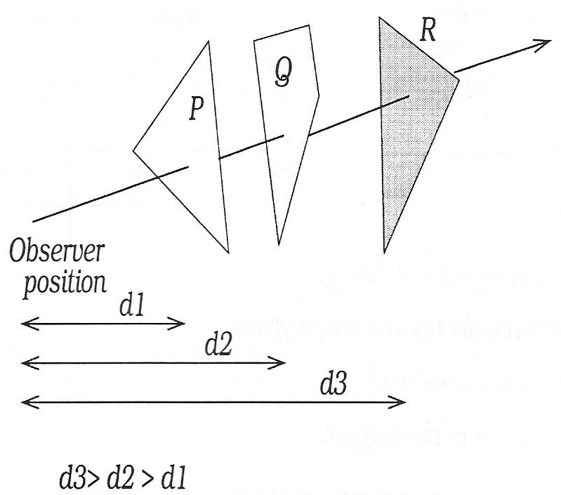
Painter’s Algorithm
Sort all polygons by z-depth
Scan-convert polygons in back-to-front order So paint poly R first, then Q, then P
Cannot handle certain cases:
Cyclic polygons
Intersecting polygons

Slide 11

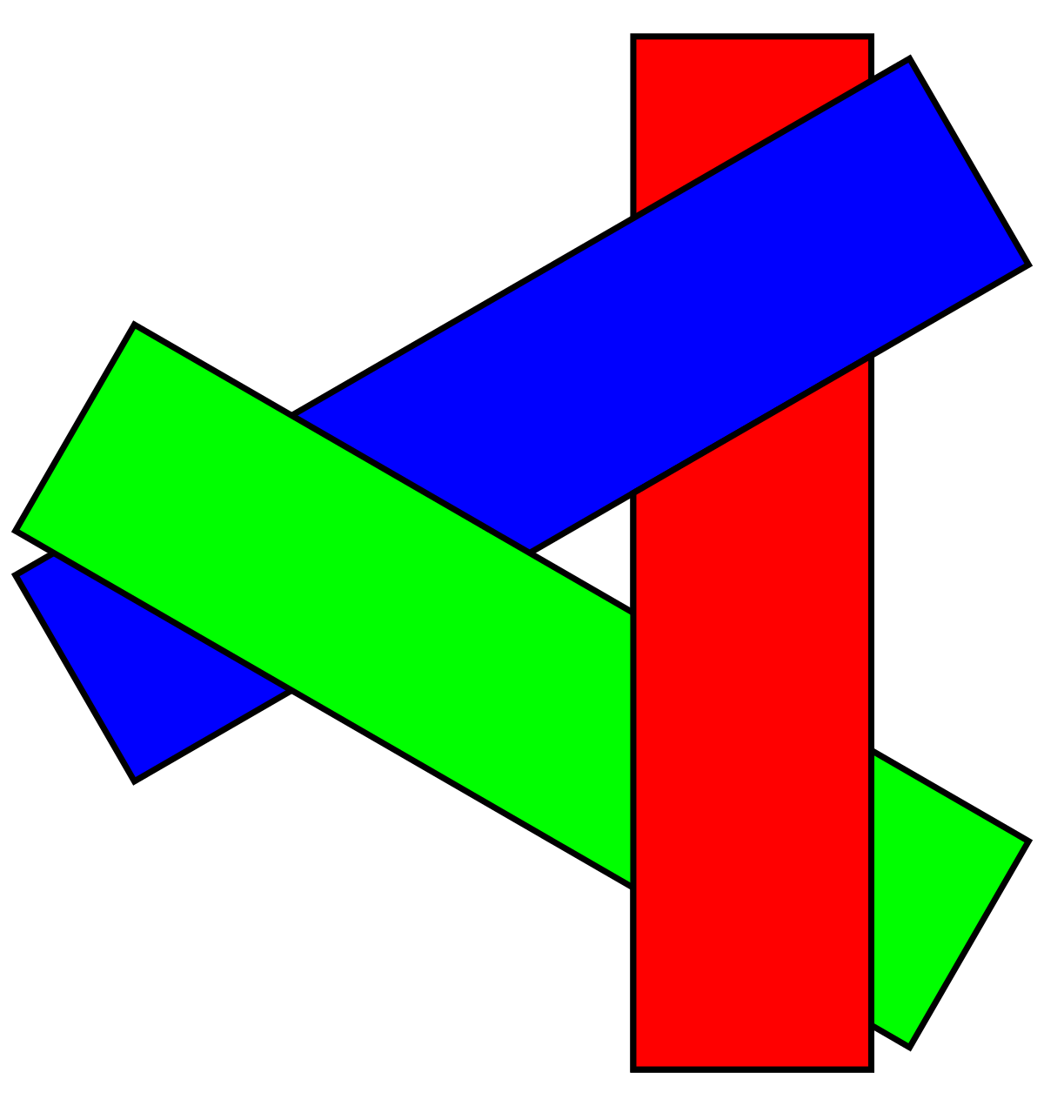
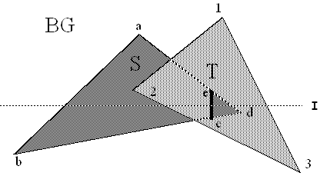
Painter’s Algorithm

Slide 12
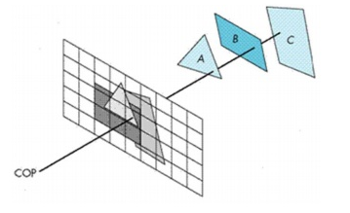
Z-Buffer Algorithm
zb[X_{res}][Y_{res}] = ∞
cb[X_{res}][Y_{res}] = background
for each polygon
for each pixel covered by polygon
Calculate z for polygon at (x,y)
If (z < zb[x][y])
zb[x][y] = z
cb[x][y] = color of polygon

Slide 13
Z-Buffer Algorithm
Properties
Image/screen precision algorithm
Easy to implement in software and hardware
Polygons scan-converted into framebuffer in random order
No pre-sorting of objects/polygons necessary

Slide 14
Z-Buffer Algorithm
Disadvantages
Memory requirements for storing color and depth for entire image
Aliasing issues
Complexity depends on polygon’s projection area on the screen
Hard to handle transparency

Slide 15
Z-Buffer Algorithm
Advantages
Handles penetrating and cyclic objects
Extends to various kinds of faces other than polygons
Simplicity and ease of software implementation
Easily implementable in hardware
Be modified to reduce memory requirements
Can be extended to A-buffer to reduce aliasing
Theoretically it can handle any number of polygons

Slide 16
Scanline Z-Buffer Algorithm
zb[X_{res}]; cb[X_{res}];
for each scanline (y = scanline, reset zb and cb)
for each polygon which intersects scanline
scan convert for specific scanline; determine span segment
for each pixel in span segment (x = pixel location)
Calculate z for polygon at (x,y)
if (z < zb[x])
zb[x] = z
cb[x] = color of poly

Slide 17
Scanline Z-Buffer Algorithm
Advantages
Same as z-buffer
Less memory requirement than z-buffer
Disadvantages
Multiple passes through polygon database

Slide 18

Efficiency Considerations in Z-Buffer Algorithms
Speed Considerations
Bounding box testing
Y_{min}/Y_{max} test: associate Y_{min}/Y_{max} with each face (Step 2)
Calculate left and right ends: x-intercept with scanline (Step 3)
Incremental calculation of Z or bilinear interpolation (Step 5) Ax + By + Cz + D = 0 z = - $\frac{Ax+By+D}{C}$ z_{x+1} - z_{x} = - $\frac{A}{C}$ ⇒ z_{x+1} = z_{x} + ∆z (where ∆z = -A/C)
Space subdivision
Hierarchical subdivision

